Slide 1
Deep Learning Course
Linear Regression

Slide 2
Linear Regression
Fundamentals: Neural Networks ← Linear Regression and Logistic Regression
Handwaving Problem Statement: Learn to predict a Target (output) for some Features (input) based on some training data
Target = f(input)
I need to figure out f

Slide 3
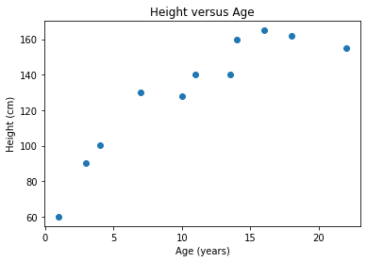
Linear Regression Problem Example
age = [ 1. 3. 4. 7. 10. 11. 14. 13.5 16. 18. 22. ]
height = [ 60. 90. 100.5 130. 128. 140. 160. 140. 165. 162. 155. ]

Slide 4

Linear Regression Definition
Linear Regression is an approach to modeling the relationship between a Target and Features with a parameterised function.
The most basic function we can fit to our example is a straight line of the form:
𝑌=𝑚𝑋+𝑐
where X is our input, Y is our output, 𝑚 defines the slope of the line and c defines the line's offset from the origin.
While the notation above is the one we use in school, the version we use in Machine Learning is like this:

Slide 5
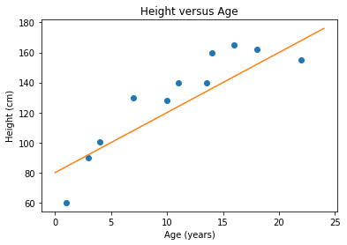
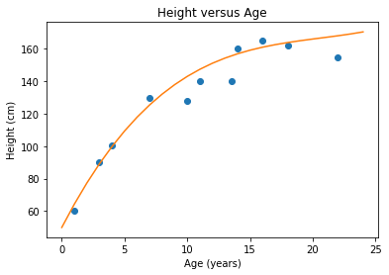
Example Functions against our Data
Y = 80 + 4X
𝑌=50+15𝑋−0.68

Slide 6
The Error or Loss of our Functions

Slide 7
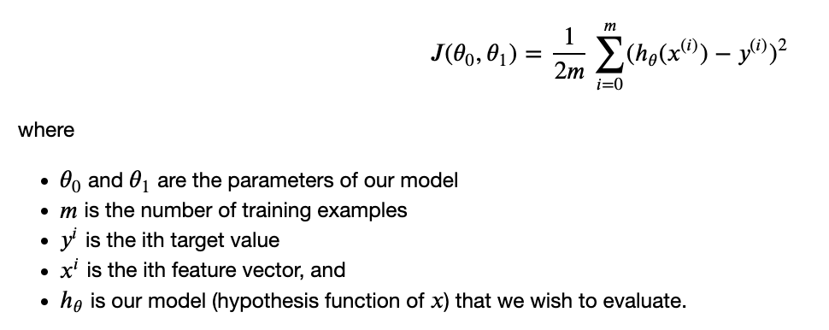
Sum of Squared Error

Slide 8
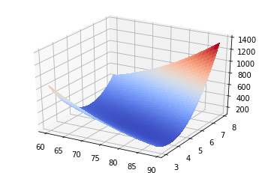
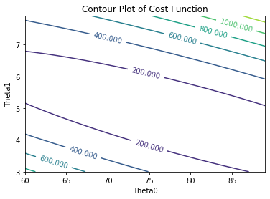
Visualising the Cost Function

Slide 9
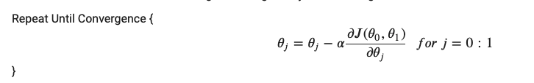
Finding the Parameters - Gradient Descent

Slide 10
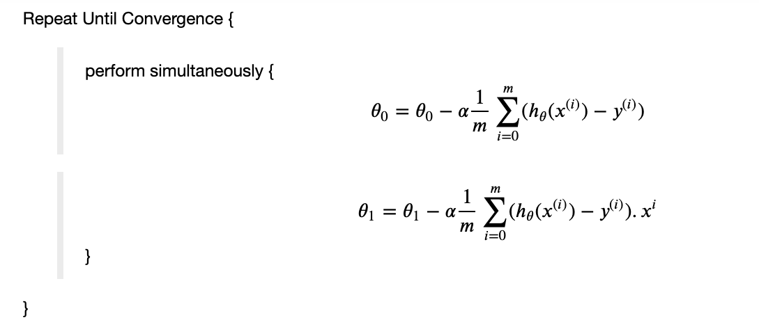
Finding the Parameters - Gradient Descent

Slide 11
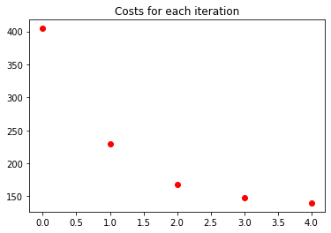
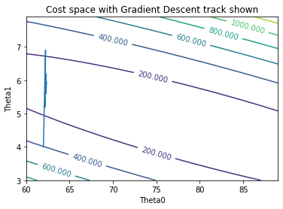
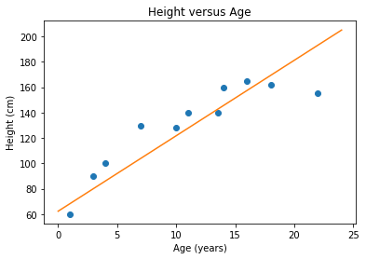
Results on our Sample Data

Slide 12
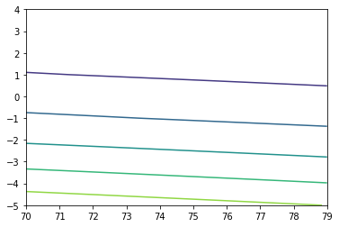

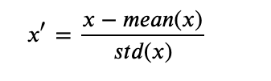
Normalising our Data

Slide 13
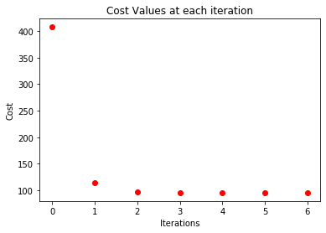
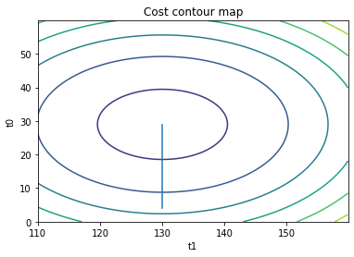
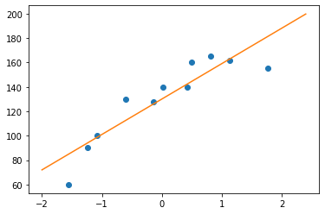
Gradient Descent After Normalisation

Slide 14

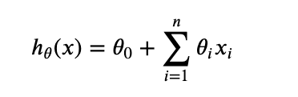
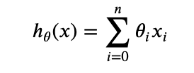

Multivariate Linear Regression

Slide 15
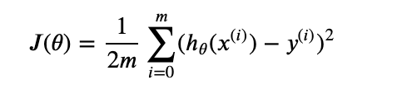
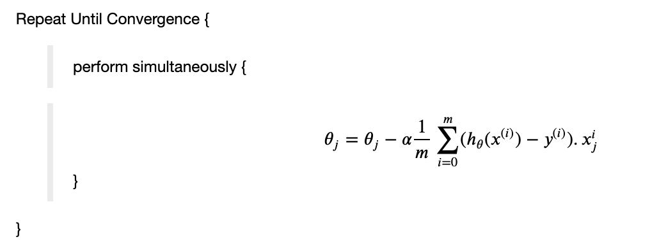
Multivariate Loss and Gradient Descent

Slide 16
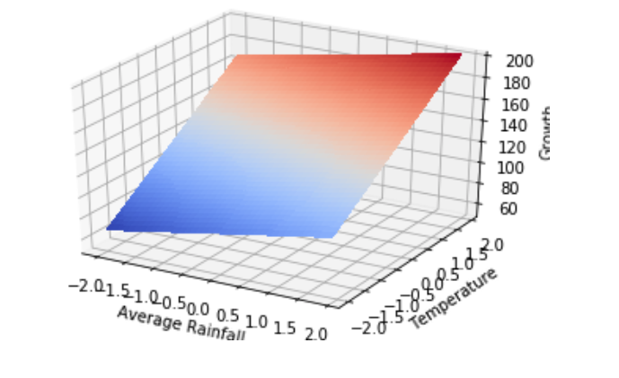
Multivariate Example

Slide 17
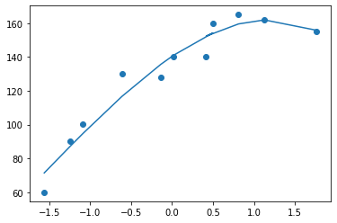

More Complex Linear Functions

